Slide 1




Online Training
Video Server
192.168.110.1/24
Course Development
FTP Server
192.168.120.1/24
Headquarter
G0/0/0
G0/0/0
HQ-R1
G0/0/8
G0/0/8
HQ-R2
G0/0/9
G0/0/9
100.1.1.1/30
100.2.1.1/30
MPLS
Internet
Web Server
100.1.2.1/30
100.1.3.1/30
100.2.3.1/30
100.2.4.1/30
100.2.2.1/30
G0/0/9
G0/0/8
G0/0/8
G0/0/9
100.1.4.1/30
G0/0/9
G0/0/9
Branch-A-R1
G0/0/8
G0/0/8
Branch-A-R2
Branch-B-R1
Branch-C-R1
G0/0/0
G0/0/0
G0/0/0
G0/0/0
Branch A
Branch B
Branch C
Course Development
Branch-A-2-PC
Online Training & Course Develop
Branch-B-1-PC
Online Training & Course Develop
Branch-C-1-PC
Online Training
Branch-A-1-PC

Slide 2
Login information:
Devices | Port | IP address :port | Mask | Username /password
Headquarter R1 | 3001 | 172.18.135.16:3001 | 17 | admin/Huawei@123
Headquarter R2 | 3002 | 172.18.135.16:3002 | 17 | admin/Huawei@123
Branch A R1 | 3003 | 172.18.135.16:3003 | 17 | admin/Huawei@123
Branch A R2 | 3004 | 172.18.135.16:3004 | 17 | admin/Huawei@123
Branch B R1 | 3005 | 172.18.135.16:3005 | 17 | admin/Huawei@123
Branch C R1 | 3006 | 172.18.135.16:3006 | 17 | admin/Huawei@123
iMaster NCE-WAN | 18008 | https://172.21.16.199:18008/ | 17 | MSP:elabmsp@huawei/Huawei@123 Tenant：elabsdwan06/Huawei@123
Device | port | IP address |  | Username /password
Video Server | 3389 | 172.18.135.130 | 17 | huawei/Huawei@123
FTP Server | 3389 | 172.18.135.131 | 17 | administrator/Huawei@123
Branch-A-1-PC | 3389 | 172.18.135.132 | 17 | huawei/Huawei@123
Branch-A-2-PC | 3389 | 172.18.135.133 | 17 | huawei/Huawei@123
Branch-B-1-PC | 3389 | 172.18.135.134 | 17 | huawei/Huawei@123
Branch-C-1-PC | 3389 | 172.18.135.135 | 17 | huawei/Huawei@123
Email server |  | 172.21.16.240

Slide 3
Email address | Username/password
ztp6@sdwan.com | admin/Huawei@123
hq6@sdwan.com | admin/Huawei@123
branch-a6@sdwan.com | admin/Huawei@123
branch-b6@sdwan.com | admin/Huawei@123
branch-c6@sdwan.com | admin/Huawei@123

Slide 4
Please make sure to delete all your sites, equipments, and tenant/MSP accounts when you finished the training.
ZTP data plan:
Device Name | ESN | PC for ZTP | Username / Password
HQ-R1 | 6R02352CQW2190000317 | 172.18.135.130 | huawei/Huawei@123
HQ-R2 | 6R02352CQW2190000301 | 172.18.135.131 | administrator/Huawei@123
Branch-A-R1 | 6R02352CQW2190000306 | 172.18.135.132 | huawei/Huawei@123
Branch-A-R2 | 6R02352CQW2190000291 | 172.18.135.133 | huawei/Huawei@123
Branch-B-R1 | 6R02352CQW2190000295 | 172.18.135.134 | huawei/Huawei@123
Branch-C-R1 | 6R02352CQW2190000308 | 172.18.135.135 | huawei/Huawei@123

Slide 5
Underlay network data plan:
LAN port: L2 switch mode
WAN route: default route, set the 100.x.x.2 as the default gateway.
Device Name | WAN Link | Destination Subnet | Next-Hop Address | Destination IP Address
HQ-1 | MPLS | 0.0.0.0/0 | 100.1.1.2 | 100.1.1.2
HQ-2 | Internet | 0.0.0.0/0 | 100.2.1.2 | 100.2.1.2
Branch-A-R1 | MPLS | 0.0.0.0/0 | 100.1.2.2 | 100.1.2.2
Branch-A-R2 | Internet | 0.0.0.0/0 | 100.2.2.2 | 100.2.2.2
Branch-B-R1 | MPLS | 0.0.0.0/0 | 100.1.3.2 | 100.1.3.2
 | Internet | 0.0.0.0/0 | 100.2.3.2 | 100.2.3.2
Branch-C-R1 | MPLS | 0.0.0.0/0 | 100.1.4.2 | 100.1.4.2
 | Internet | 0.0.0.0/0 | 100.2.4.2 | 100.2.4.2

Slide 6
Overlay network data plan:
Each CPE uses GE0/0/0 and VLANIF to communicate with the switches connected.
And OSPF (area 0) is the overlay routing protocol.
Virtual Network | Site | Device | Physical Interface | VLAN | IP Address | LAN Routing Protocol | Protocol Interface
Online Training | HQ | HQ-R1 | G0/0/0 | 11 | 192.168.11.2/30 | OSPF | VLANIF 11
 | Branch_A | Branch-A-R1 | G0/0/0 | 21 | 192.168.21.2/30 | OSPF | VLANIF 21
 | Branch_B | Branch-B-R1 | G0/0/0 | 31 | 192.168.31.2/30 | OSPF | VLANIF31
 | Branch_C | Branch-C-R1 | G0/0/0 | 41 | 192.168.41.2/30 | OSPF | VLANIF 41
Course Development | HQ | HQ-R2 | G0/0/0 | 12 | 192.168.12.2/30 | OSPF | VLANIF 12
 | Branch_A | Branch-A-R2 | G0/0/0 | 22 | 192.168.22.2/30 | OSPF | VLANIF 22
 | Branch_B | Branch-B-R1 | G0/0/0 | 32 | 192.168.32.2/30 | OSPF | VLANIF 32
 | Branch_C | Branch-C-R1 | G0/0/0 | 42 | 192.168.42.2/30 | OSPF | VLANIF 42

Slide 7
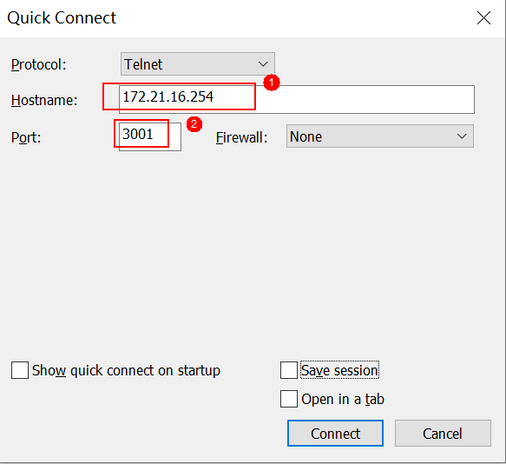
How to login devices by GUI:

